Slide 1
Voice-Based Email & Messaging Assistant Hands Free Communication
Milestone 1 :Setup and Authentication
TimeLine: Weeks 1-2 January 2026
Prepared By: Vedanti Nagesh Lavekar
Guided By: Dr. Santhiya Krishnasamy

Slide 2
Presentation Outline
Introduction
Problem Statement
Aim & Objectives of the Project
Scope of the Project
Milestone 1 Overview & Deliverables
Milestone 1 Key Achievements
Technology Stack
System Architecture
Database Design
Conclusion

Slide 3
Execution Timeline - Milestone 1
Timeline: Weeks 1–2 (January 2026)
Week 1
Requirement analysis and problem understanding
Finalization of project scope and objectives
System architecture design (Three-Tier Architecture)
Database schema design (User & UserProfile tables)
Backend setup using Flask framework
Week 2
Implementation of user registration and login
Integration of speech-to-text and text-to-speech modules
Facial authentication setup
Basic voice command flow implementation
Security configuration and initial testing
Milestone 1 review and documentation

Slide 4
Introduction
A voice-based system for managing email and messaging tasks
Enables hands-free interaction using speech recognition and text-to-speech.
Reduces dependency on keyboard and mouse-based communication
Provides secure authentication using credentials and facial recognition.
Designed using a three-tier architecture for scalability and security

Slide 5
Problem Statement
Traditional email and messaging systems rely heavily on keyboard and mouse input
Such systems are difficult to use for visually impaired users and hands-free environments
Existing voice-based solutions often lack secure authentication and accuracy
Manual interaction is time-consuming and inconvenient
There is a need for a secure, voice-driven communication system for efficient email and messaging management

Slide 6
Aim of the Project
To develop a voice-based email and messaging assistant for hands-free communication
To provide an accessible and secure communication system using voice commands

Slide 7
Objectives of the Project
To design a voice-controlled interface for email and messaging
To enable hands-free interaction using speech recognition and text-to-speech
To implement secure user authentication using credentials and facial recognition
To process and execute voice commands accurately
To store and manage user data securely using a database
To follow a three-tier architecture for scalability and maintainability

Slide 8
Scope of the Project
Develop a voice-based interface for email and messaging operations
Enable hands-free interaction using speech recognition and text-to-speech
Provide secure user authentication using credentials and facial recognition
Supports basic email functionality (planned for Milestone 2)Allow voice-based messaging operations
Manage user profiles and preferences
Store and retrieve data securely using a database
Design the system using a three-tier architecture

Slide 9
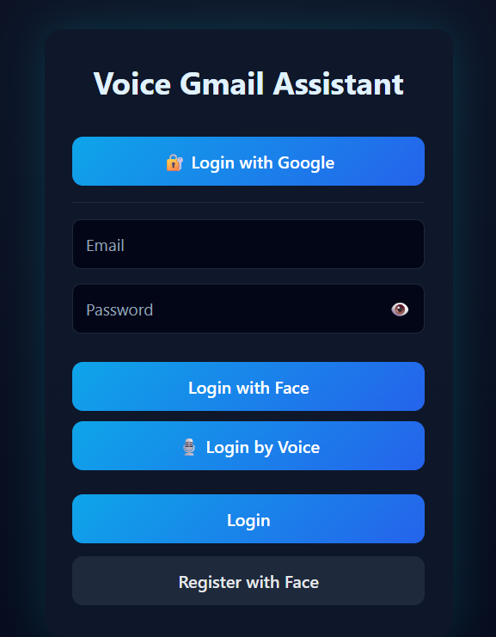
Milestone 1: Overview
Phase: System Setup & Voice Interface (Weeks 1–2)
Status: COMPLETED
System Name: Voice-Based Email & Messaging Assistant
Focus: Voice command recognition & basic communication flow
Deliverable: Functional voice interaction module for email & messaging
Ready for: Email & messaging service integration (Milestone 2)

Slide 10
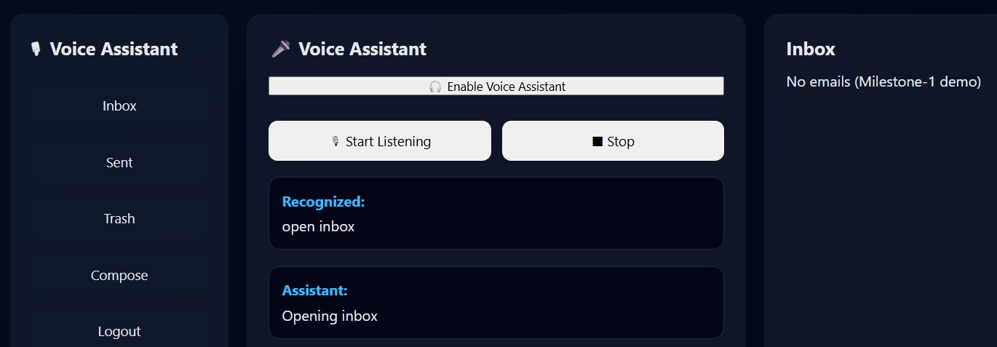
Milestone 1 Deliverables - Complete
User registration & login
Voice input (STT)
Voice output (TTS)
Facial authentication
Backend & database setup
Basic voice command flow
Security & initial testing

Slide 11
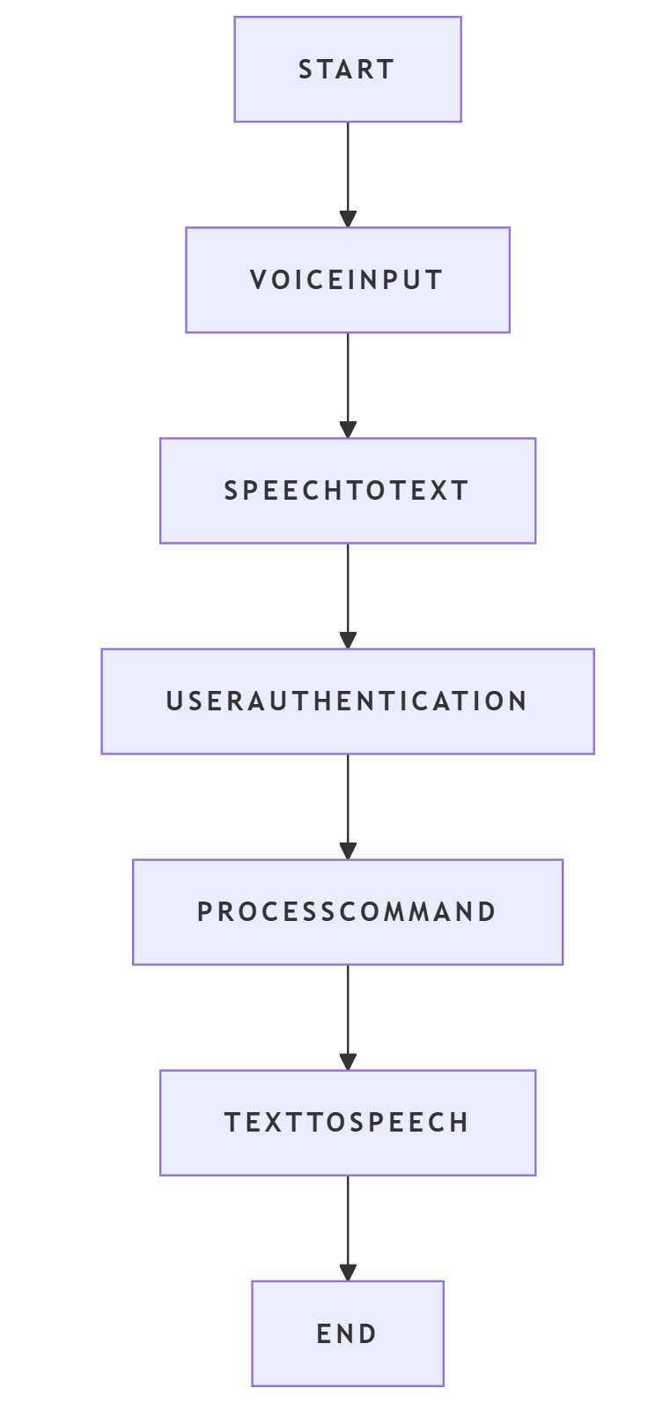
Milestone 1 – Key Achievements
Implemented voice-based user interaction
Completed secure authentication mechanism
Designed three-tier architecture
Created database schema
Established foundation for Milestone 2

Slide 12
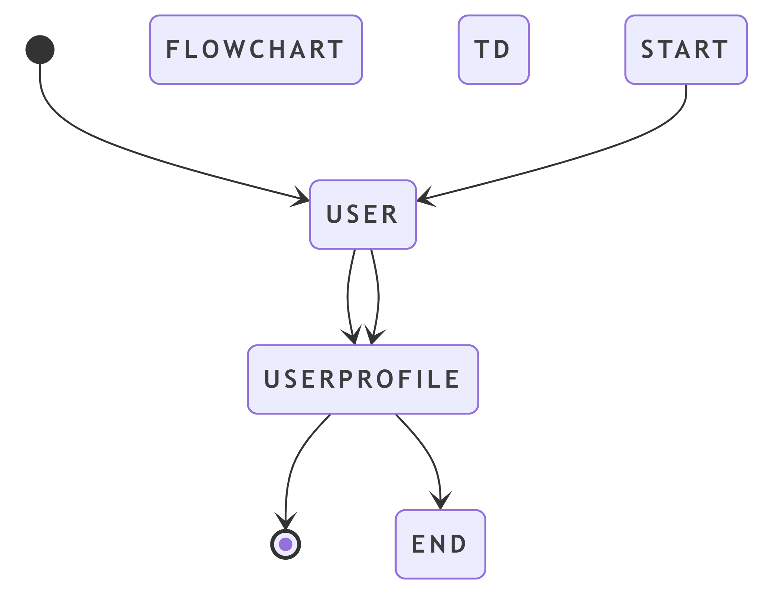
Technology Stack
Backend:
Python – Core programming language
Flask – Web framework for backend services
Flask-Login – User session management
SQLAlchemy – Database ORM
Werkzeug – Password hashing & security
Gmail API – Email sending, reading, and management
SQLite – Lightweight relational database

Slide 13
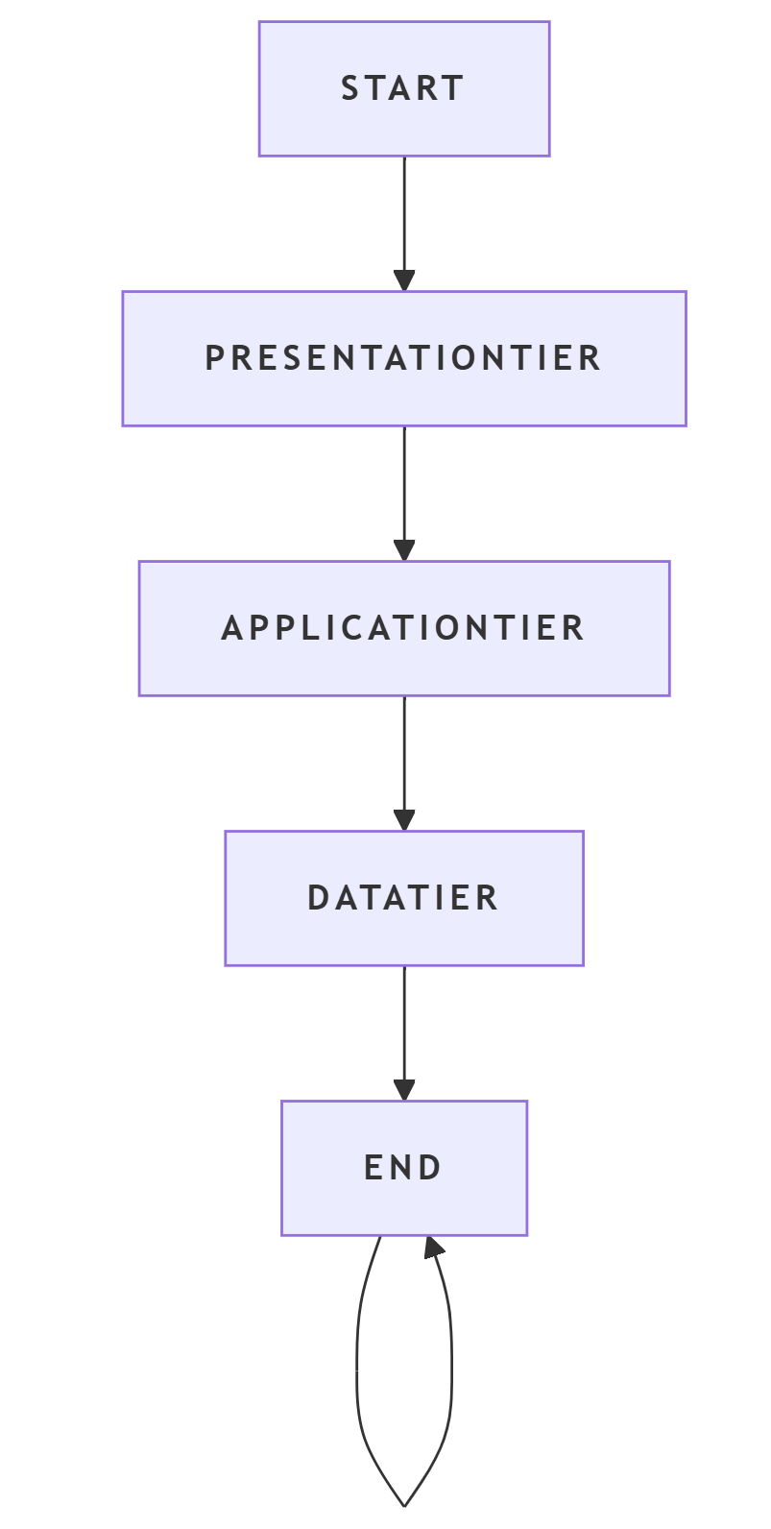
Technology Stack
Frontend:
HTML5 – User interface structure
CSS3 – Styling and layout
JavaScript (ES6) – Client-side logic
Web Speech API – Speech-to-Text (STT) & Text-to-Speech (TTS)
Face-api.js – Facial authentication (biometric verification)
Gmail API integration is planned for Milestone 2.

Slide 14
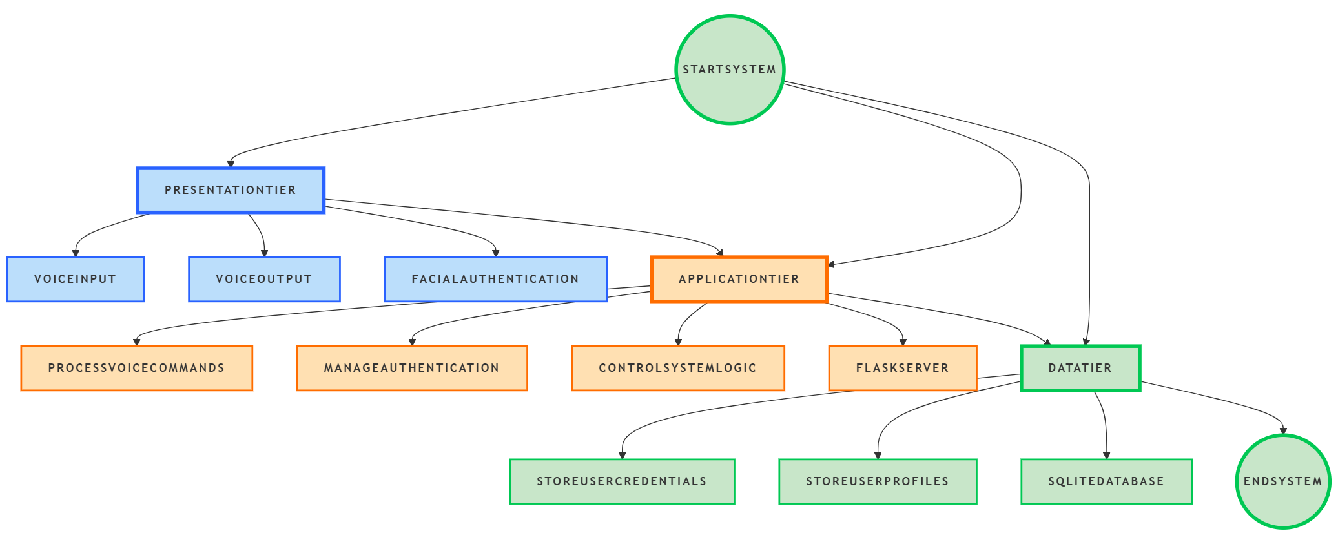
Initial System Architecture
Fig 1.1 System Architecture
This diagram represents the high-level system flow between client, server, database, and external services.

Slide 15
Database Design User Table
Column Name | Data Type | Description
id | Integer | Unique user identifier
email | String | User email (login ID)
password_hash | String | Encrypted user password
name | String | User display name
created_at | DateTime | Account creation time

Slide 16
Database Design User Profile Table
Column Name | Data Type | Description
id | Integer | Primary key
user_id | Integer | References User table
language | String | Preferred language
voice speed | Float | Text-to-speech speed
voice pitch | Float | Text-to-speech pitch
face_image_path | String | Facial image storage path
preferences | Text | Additional user settings

Slide 17
Conclusion
Milestone 1 focused on system setup, voice interface implementation, authentication mechanisms, and architectural design. A strong foundation has been established for email and messaging integration in Milestone 2.

Slide 18
Milestone 2:Core Speech and Email Integration

Slide 19
Milestone 2 – Introduction
Milestone 2 focuses on integrating voice commands with real email services
Enables users to interact with Gmail using speech only
Forms the core functionality of the Voice-Based Email Assistant
Ensures hands-free email access and management

Slide 20
Problem Statement
Traditional email systems require manual interaction
Difficult for visually impaired or physically challenged users
Need for a hands-free, voice-controlled email solution
Existing voice systems lack real Gmail integration

Slide 21
Objectives of Milestone 2
Implement Speech-to-Text for voice commands
Integrate Gmail API for real email operations
Enable voice-based email composition
Allow voice-controlled navigation of Inbox, Sent, and Trash
Ensure secure and authenticated email access

Slide 22
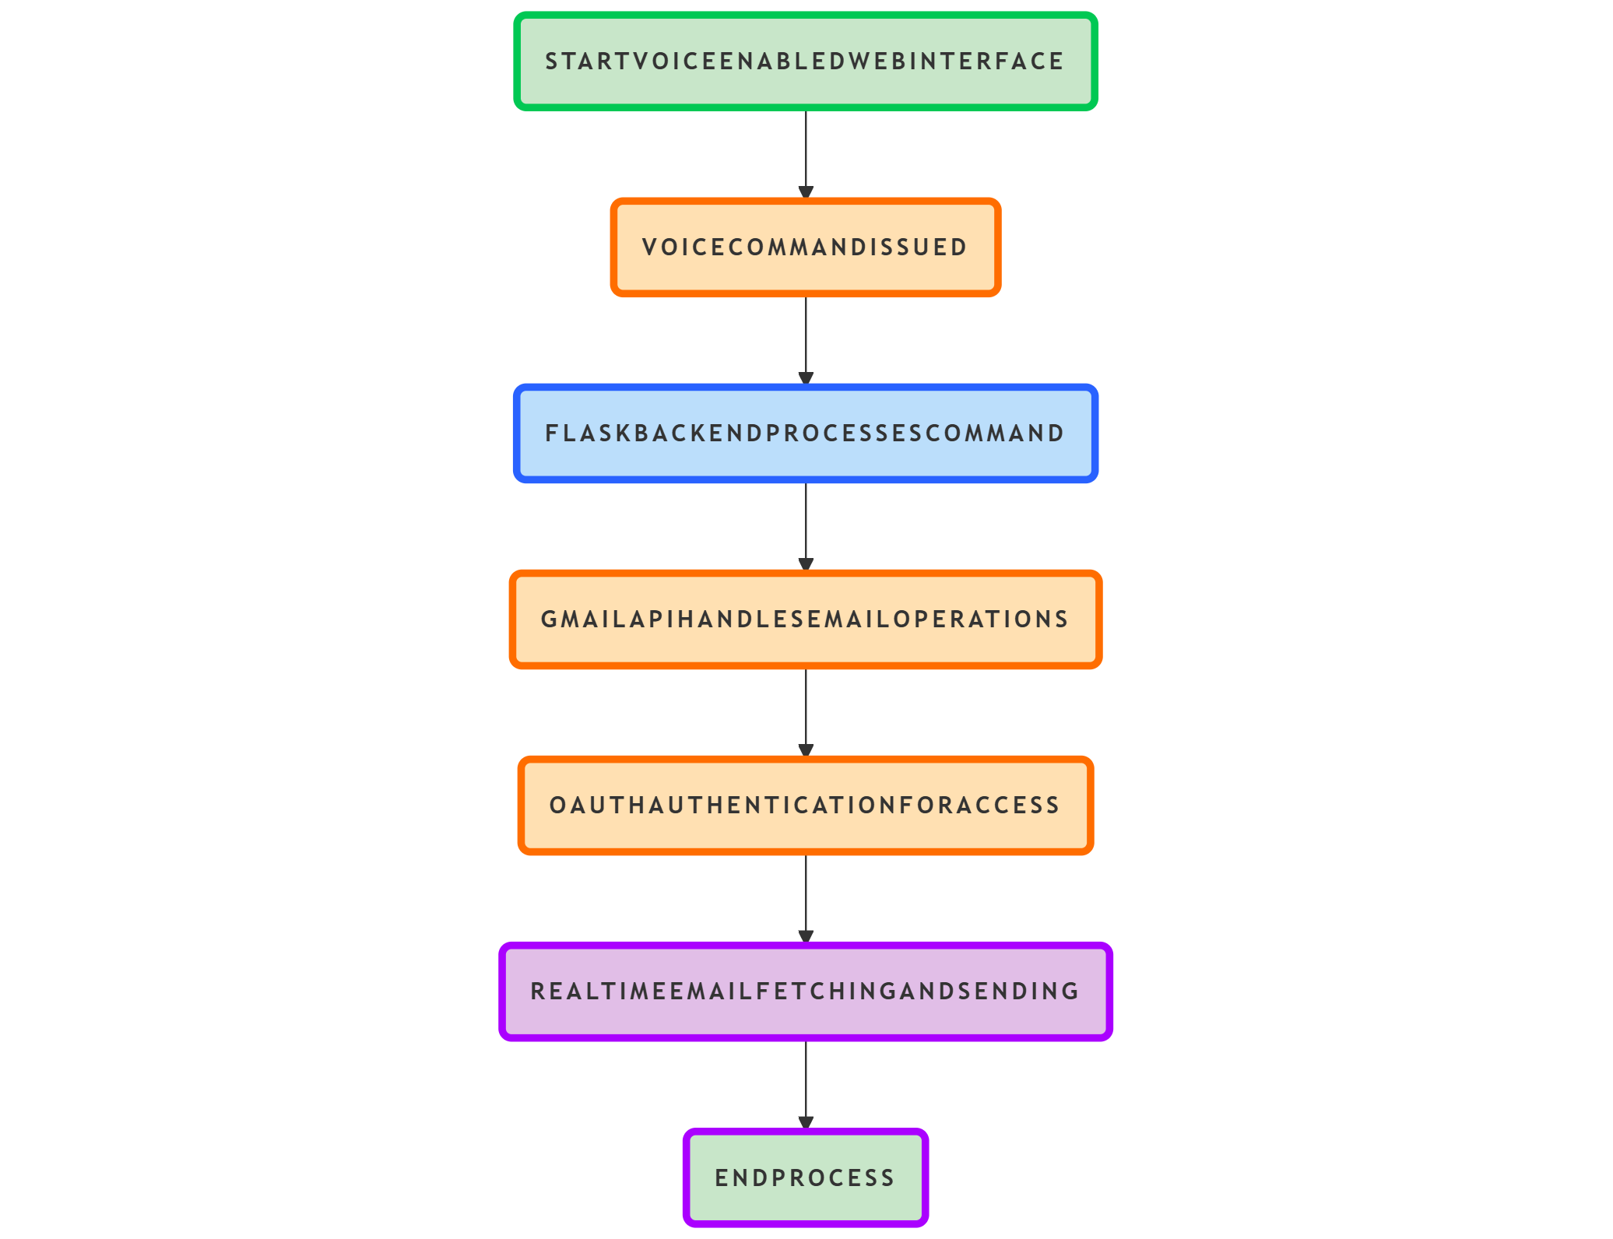
Voice Command Capabilities
Open Inbox using voice
Open Sent folder using voice
Open Trash folder using voice
Read specific emails by number
Compose email using voice only
Confirm or cancel actions using Yes/No commands

Slide 23
Voice-Based Email Reading Flow
User initiates email reading command (e.g., “Open Inbox”)
Assistant fetches emails from Gmail using Gmail API
Assistant announces the total number of emails
Assistant lists emails with sender and subject
User selects an email by voice (e.g., “Read first email”)
Assistant reads the email content aloud
User can continue reading or switch folders using voice commands

Slide 24
Voice-Based Email Composition Flow
User initiates compose command
Assistant requests recipient email
Assistant requests subject
Assistant requests message content
Assistant confirms before sending
Email is sent through Gmail API

Slide 25
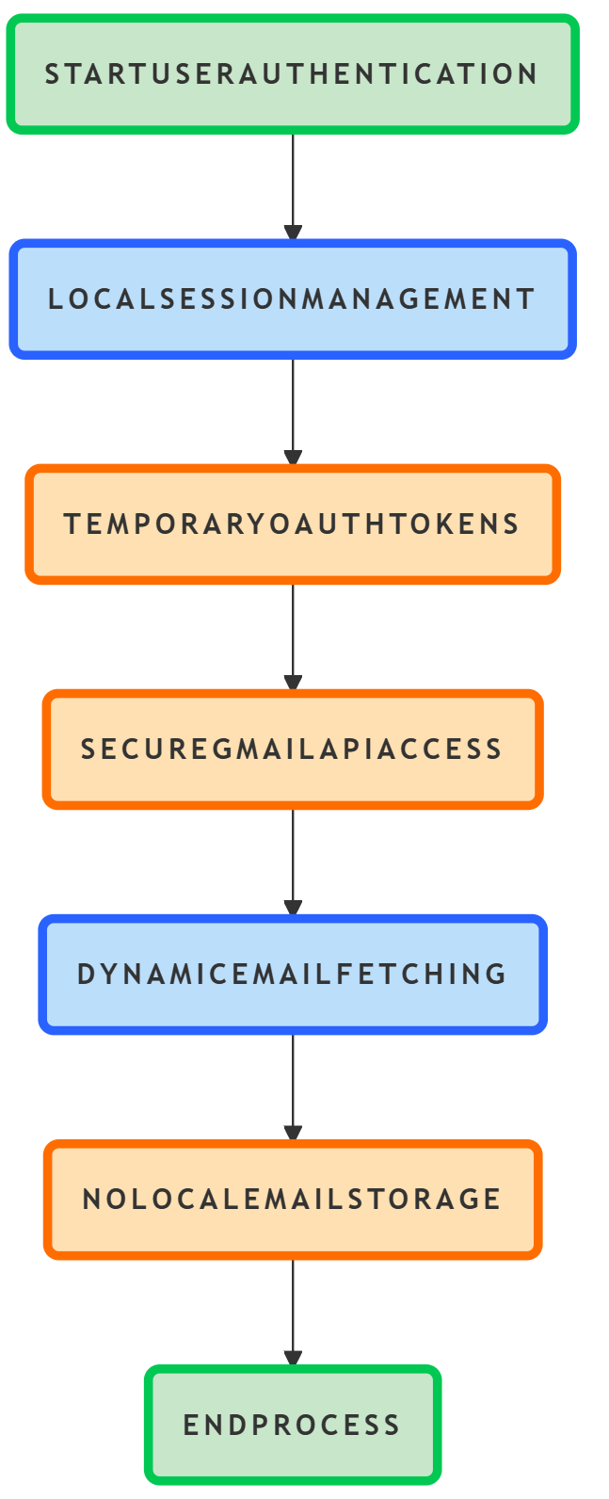
Gmail API Integration and Database Flow
Fetches emails from Inbox
Fetches emails from Sent folder
Sends emails using Gmail API
Uses Gmail labels for folder navigation
Emails are delivered to actual Gmail account

Slide 26
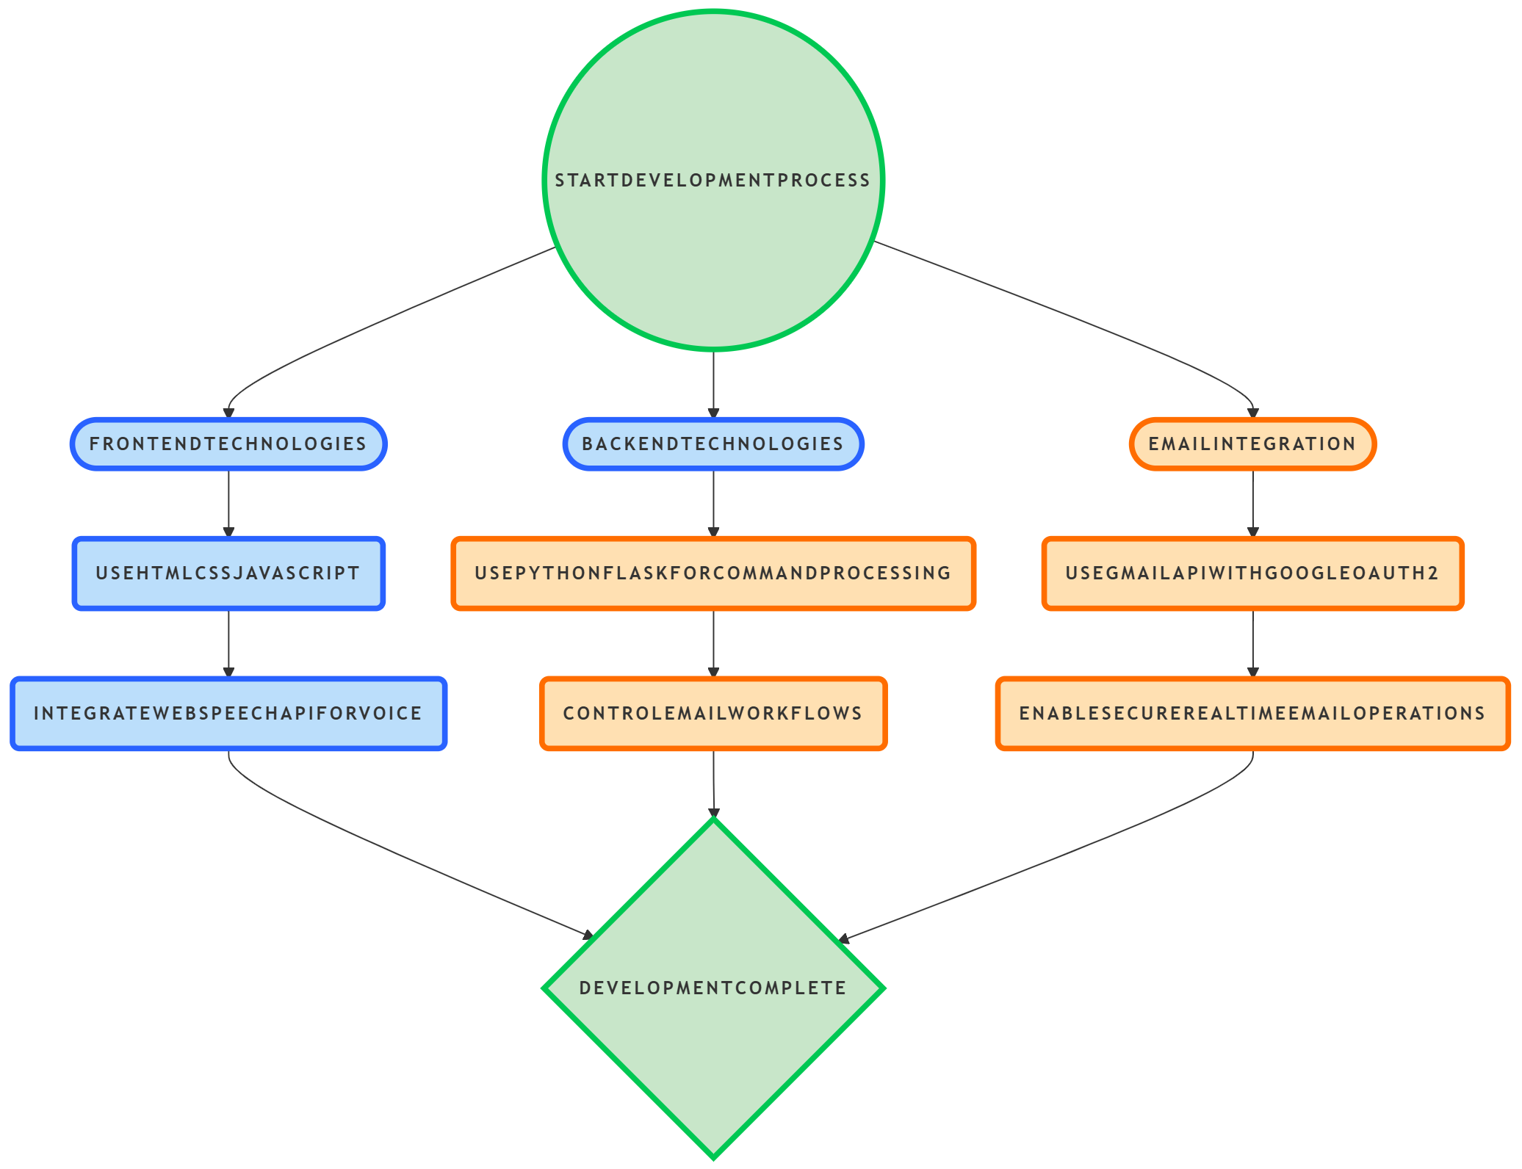
Technologies Used Diagram

Slide 27
Error Handling & Validation
Voice input validation
Email address sanitization
Confirmation before sending emails
Graceful handling of invalid commands
Prevents accidental email actions

Slide 28
Milestone 2 Conclusion
Successfully integrated voice with Gmail services
Core email functionalities achieved
Secure and reliable system implemented
Ready for advanced AI features in next milestone

